Slide 1
３．宇宙はどんな世界
Overview of the Universe
天文学、宇宙物理学に関する基礎知識
Introduction to astronomy and astrophysics
English translation by Tomita Akihiko and Lieza Crisostomo, 11 March 2019

Slide 2
Really?
Eureka!
星の輝きと私たちの存在は、本当につながっている。
宇宙は姿を劇的に変えて今に至り、
その中で私たちが存在している。
Brilliant star lights and our own existence are really connected with each other, scientifically!
The universe has changed its shape dramatically, and in the long history, just in a second, we live.

Slide 3
星（star）
ここでは、太陽のように自ら光り輝く恒星（恒星）のこと。
星座の星々は恒星です。遥か遠くの太陽たち、です。
The stars refer to fixed stars, self-luminous bodies like the Sun.
The pinpoint lights of constellations are stars, the distant Suns.
ひとこと：地球は自ら放射をしていない、ということはない。
太陽熱のため込み以外に、地球独自の熱源がある。
Note: That Earth does not radiate by itself is not true.
Other than receiving sunlight and heat, Earth has its own heat source.
考えてみよう：地震は太陽熱エネルギーが変換されたものか？
そのエネルギーは、どこからやってきたものか？
Think: Is earthquake due to conversion of solar heat energy?
Where is the energy source of the earthquake coming from?

Slide 4
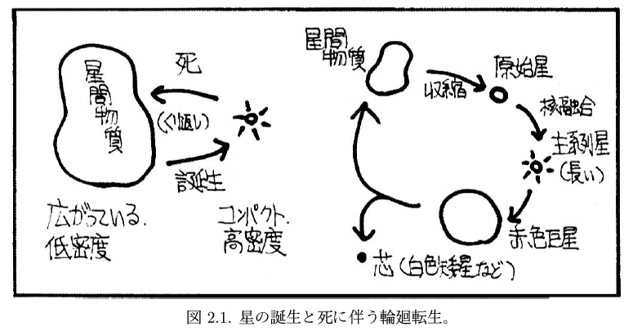
宇宙に浮かぶ物質における、星という「相」
The “phase of matter” in the form of star in the universe
interstellar matter
interstellar matter
death
protostar
nuclear fusion
collapse
repeat
main sequence star
(long lived)
star formation
diffuse and
low density
compact and
high density
red giant
ember (white dwarf and others)
星という姿になった時、星が誕生、と表現する。
When the matter forms stars, we call that stars are born.
星という姿でなくなった時、星が死、と表現する。
When the matter is no longer stars, we call the stars die.
星の姿になったりならなかったり、輪廻転生を繰り返している。
At times stars, at other times not stars, the cycle of rebirth.

Slide 5
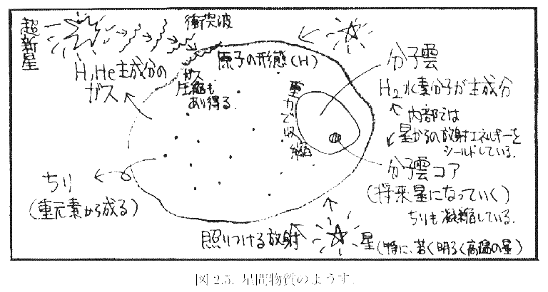
星が生まれる
Stars are born.
supernova explosion
shock wave
molecular cloud
atomic phase
mainly H₂ molecules
gas, mainly of H and He
Inside is shielded from star’s radiation.
Shock wave can trigger the compression of the gas.
collapse by the self gravity
molecular cloud core
(future star)
irradiation from stars
dust, made of heavy elements
Dust is also concentrated.
newly born stars, especially bright and hot ones
重力で縮んでいく。
It collapses on itself due to self gravity.
「外的な助け」で収縮が促進される場合がある。
“Help from outside” can accelerate the collapse.

Slide 6
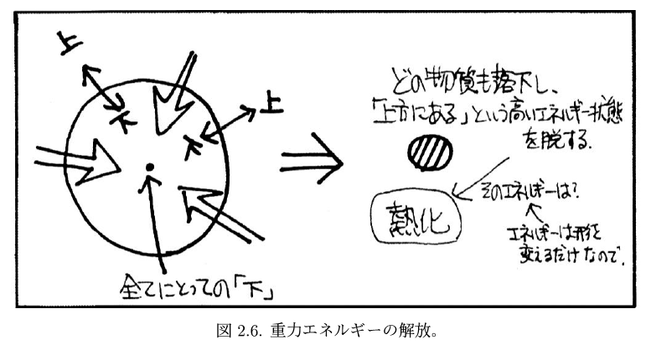
星が「光る」
Stars begin to shine.
up
All matter falls down, ending the state of “being upward.”
up
down
down
What is the heat source?
bottom for all
thermalized, being hotter
Energy simply changes its form.

Slide 7
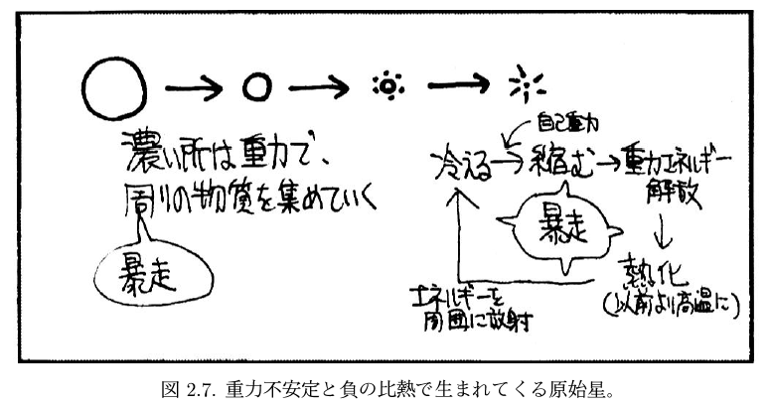
最終的には「圧力」と拮抗して、収縮は止まる
Finally, the self gravity going inward counteracts the pressure going outward, and the collapse stops.
by self gravity
cools by shining
releasing the gravitational energy
collapses
The denser the place is, the stronger the gravity is, leading to gather more material from surroundings.
run away
run away
thermalized
more hotter than before
radiation of energy (light and heat)
中が熱ければ、エネルギーが周囲に流れ出て「光る」。
しかしこれでは縮みきったらおしまい。
When the inside is hotter, energy (light and heat) flows outside, which means the body is shining. However, after the system finish infalling, the body stops shining.
「光り続ける」ために、いつでも中が熱くなる「エンジン」を持っている。→核融合反応
If the body is shining steadily, the body has to have the engine of heat source inside.
→ nuclear fusion
注：核融合がなければ天体は光らない、ということではありません。それ以外の方法で光る天体もあります。星は核融合を通して長期間安定に光っている、ということです。
Note: The nuclear fusion is not the only mechanism for objects to shine. There are shining objects with other mechanism. The stars shine steadily for a long time because of nuclear fusion.

Slide 8
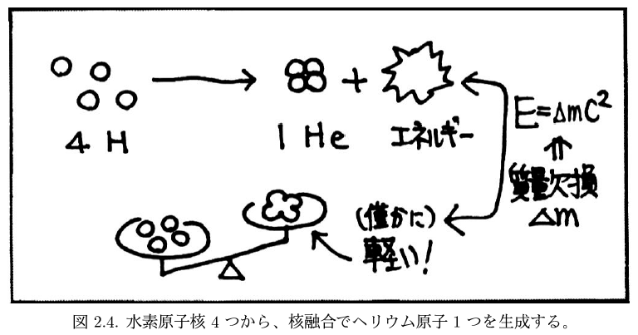
核融合です、核分裂ではありません
Nuclear fusion, not the nuclear fission we use for electricity generation
陽子（水素原子核） proton (hydrogen atom nucleus)：
正の電荷を持っているものどうし、High temperature and high pressure are necessary
合体させるには高温高圧が必要 for electrically positive particles to coalesce.
Energy output
mass defect
Output particle is slightly lighter than total mass of original particles
（質量＋エネルギー）が保存
Total of (mass + energy) conserves.
Hydrogen nuclei are stable and helium nuclei are also stable. He is much stable than H in terms of energy level,
but sticking H atoms to make a He atom need much force to overcome the “wall” which makes the H atoms stable.

Slide 9
星間ガス（星間雲） interstellar clouds of gas and dust
特に濃いところ especially dense region
分子雲 molecular clouds （特に、分子雲コア esp. molecular gas core）
集団として星形成 star formation as a group
質量の違う多くの星 many stars with different masses
基本は、ガスの塊→星の集団
Basic trend is from clumps of clouds to a group of stars
できた星からの放射による周囲のガスの蒸発、
星からの風、さらには超新星爆発による周囲のガスの吹き飛ばし
Evaporation of surrounding gas by radiation of newly formed stars,
the surrounding gas is being blown off by stellar winds and supernova explosions
母体のガス塊から、星団が姿を現す
The star cluster appears from the clouds which gave birth to the stars.
星団のメンバーの星数が少ないと、星の間の重力の結びつきが十分でなく、
いずれ、星が各自散らばっていき、星団という系がなくなる。
If the number of stars in the cluster is not enough, the mutual gravitational pull is not so
strong that stars will be separated with each other, breaking the system of star cluster.

Slide 10
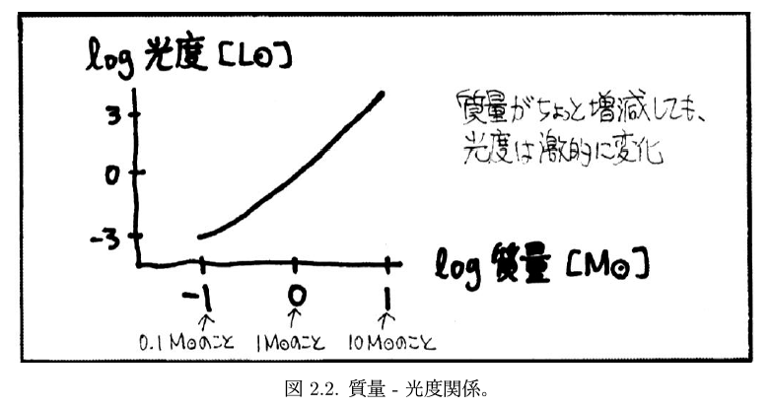
星の光度は、「桁違い」である!
Luminosity variety of stars spans several orders of mag.
Luminosity in the unit of solar luminosity
星「本来の」明るさは、本当に色々
Even a slight change in mass leads to a dramatic change in luminosity.
Luminosity of stars, true brightness not apparent brightness: from very faint to very bright
Mass in the unit of solar mass
星としての寿命 ∝ 光度 / 質量
lifetime of a star ∝ luminosity / mass
→ 寿命は「大質量星ほど短い」
The more massive a star is, the shorter its lifetime is.
金持ち程、はやく貧乏になる
The rich gets poorer faster.

Slide 11
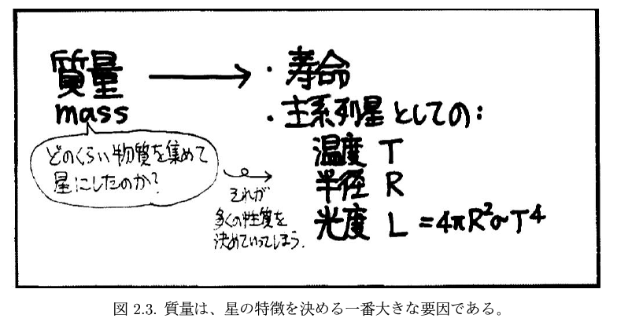
星の中心部で「水素→ヘリウム」の核融合が行われている、比較的長期間安定して光り輝く段階： 「主系列星」
At the core of a star, nuclear fusion from H to He occurs and the star shines steadily for a long time: main sequence star.
lifetime
parameters as a main sequence star
temperature
radius
How much material for formation of a star
luminosity
Mass determines many parameters.
主系列星（太陽も、この段階）では、大質量ほど、高温であり（青白い色になる）、半径が大きい。
For main sequence stars (the Sun is also in this stage), the more massive the star is, the higher the surface temperature will be, hence a bluer color, and a bigger radius.
ただし、それは一桁程度の違いになるかどうか程度。
光度は桁違いに大きくなる（距離の効果を無視すれば、明るく見える）。
For main sequence stars, the varieties in temperature and radius are about an order of magnitude, but luminosity has much wider variety. The luminous one appears quite bright if it is not far.

Slide 12
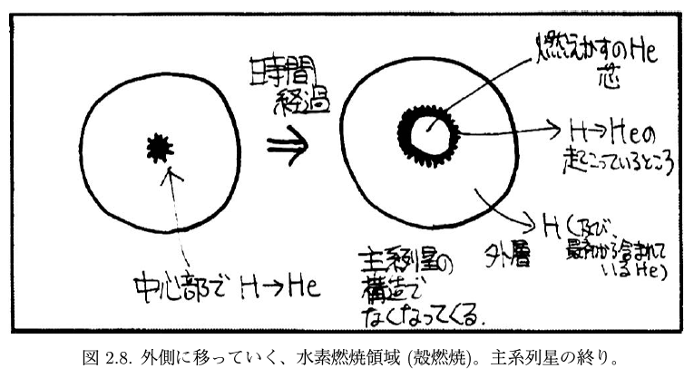
星も中年になると、老廃物がたまって太る。
As the star ages, waste material stays inside the star, getting a star fatter.
He core , the ember
As time passes…
the shell where H → He takes place
No longer not a main sequence structure
outer layers
H → He at the core
H and original He

Slide 13
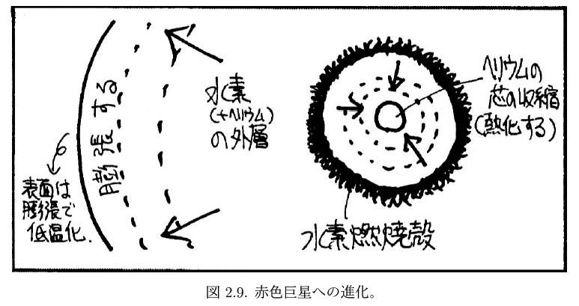
contracting of He core
expand
Outer layers of
H and original He
thermalized
H burning shell
By expanding, the surface temperature cools down.

Slide 14
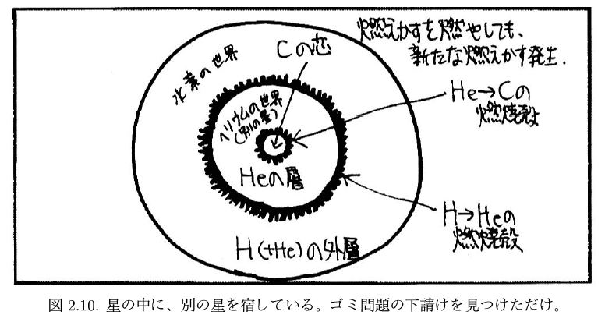
ゴミ問題の下請け
subcontract of garbage problem
Burning the ember leads to another new ember.
realm of H
core of C
He → C
burning shell
realm of He
(another engine inside)
layers of He
H → He
burning shell
outer layers of H
赤色巨星は、表面温度は低いが（だから「赤色」）、光度は大きい。だから、太陽が赤色巨星化したら地球が干上がるのは、半径が増大（巨星化）するからだけではなく、光度が増大するからである。
A red giant has a lower surface temperature, therefore, a redder color, but more luminous. Hence, when the Sun becomes a red giant, the Earth will be boiled up because not only the Sun’s radius is larger but also the Sun radiates much more energy.

Slide 15
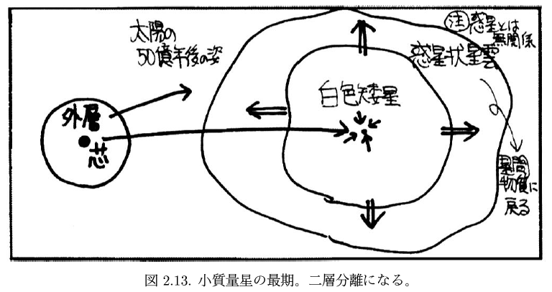
中小質量星の最期
demise of middle and low-mass stars including the Sun
Note: independent of the planet
The Sun,
5 billion years from now
planetary nebula
outer layers
white dwarf
core
return to
the interstellar medium

Slide 16
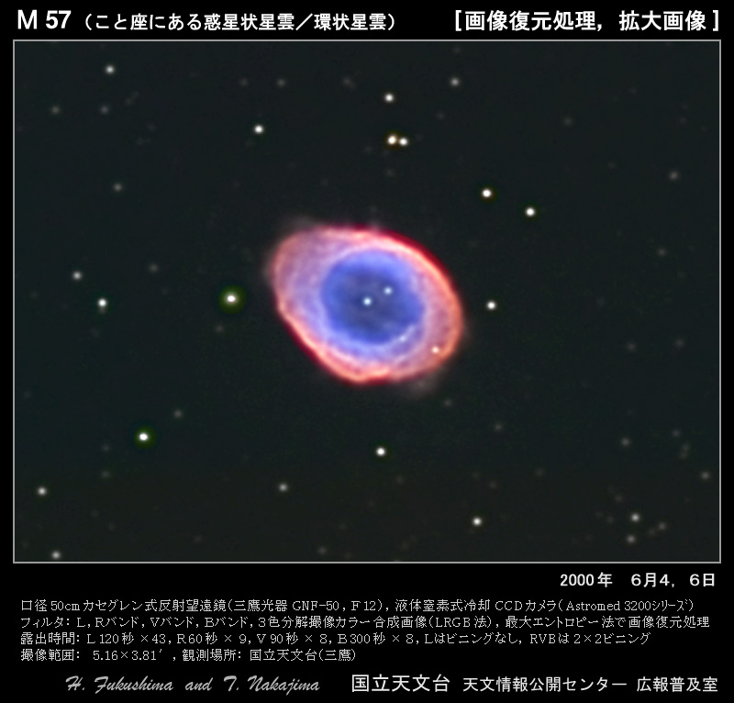

Slide 17
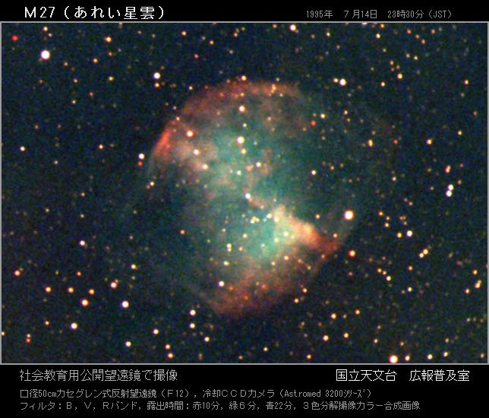

Slide 18
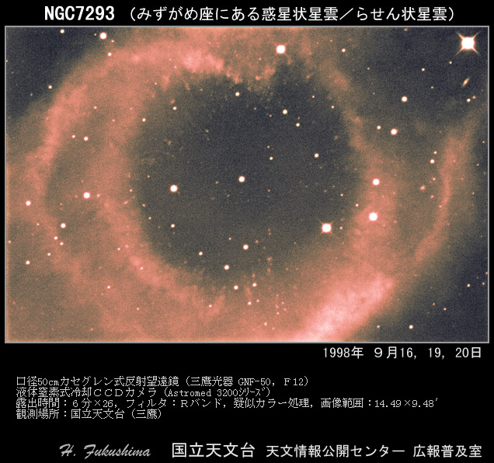

Slide 19
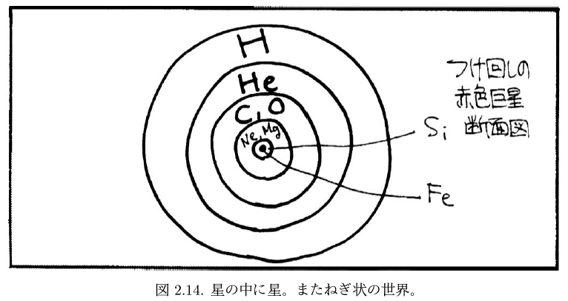
大質量星の最期
demise of massive stars
putting off the ember-burning on and on…
a schematic cross section of a red giant
なかなかしぶとい。
Quite stubborn, the massive red giant…

Slide 20
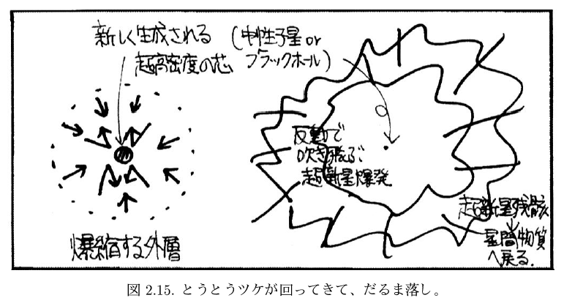
最期は破滅的
The ending is destructive.
newly-formed ultra-dense core
neutron star or black hole
blown off
by bouncing
supernova remnant
infalling, implosion of outer layers
return to the interstellar medium
超新星爆発までに、鉄までの重元素合成を行い、超新星の際に鉄以降のもっと重い元素を合成する。もっと重い元素（たとえば、金銀銅の貴金属）合成は中性子星合体の際も生成されると考えられている（貴金属の由来は、宇宙での元素合成の大きな課題のひとつ）。超新星爆発は、星間物質の収縮を助ける場合もあり、それが新しい星形成につながることがある。破壊が誕生を、死が生を促す、とも言える。
Before the supernova explosion, heavy elements up to Fe, the 26th element, are made. During the supernova explosion, much heavier elements are created. The heavier elements are also created during the NS merging. The supernova can help trigger the contraction of the interstellar medium leading to a new star formation.
私たちの存在は、先代の超新星に追うところ、大。 Our existence greatly depends on previous supernovae.

Slide 21
星の輝きの「結果」
The “result” of star’s light…
重元素合成
Heavy elements have been made…
いずれ、惑星の「大地」
Eventually, the ingredients of “land” of the planets,
そして「生命」さらには「知性」へ
…and of “life” and furthermore, of “intelligence”…
We are really part of the universe.
We, human beings, are all made of stardust.

Slide 22
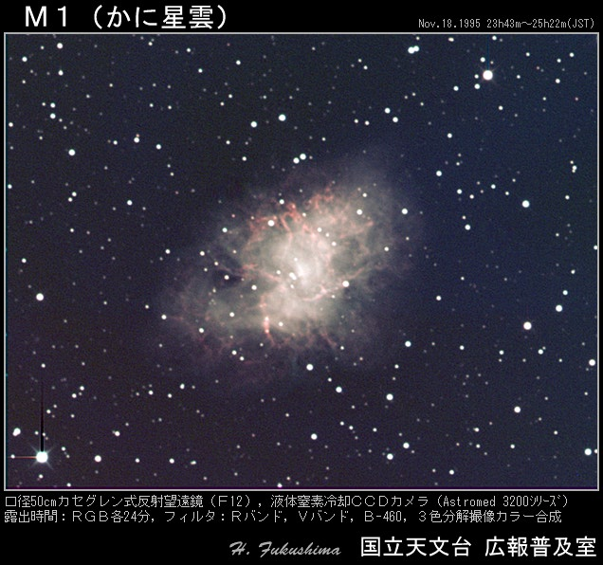

Slide 23
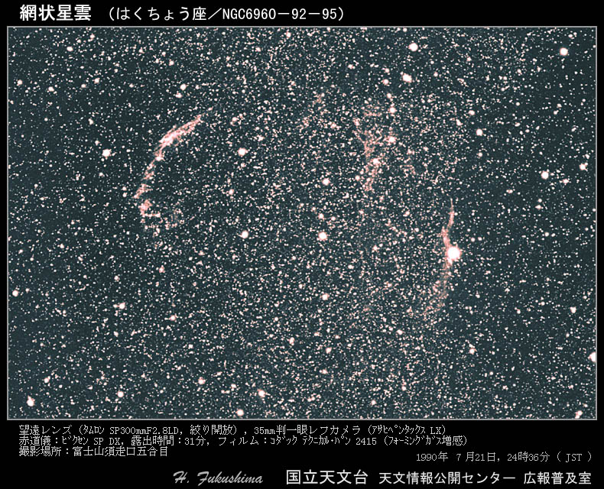

Slide 24
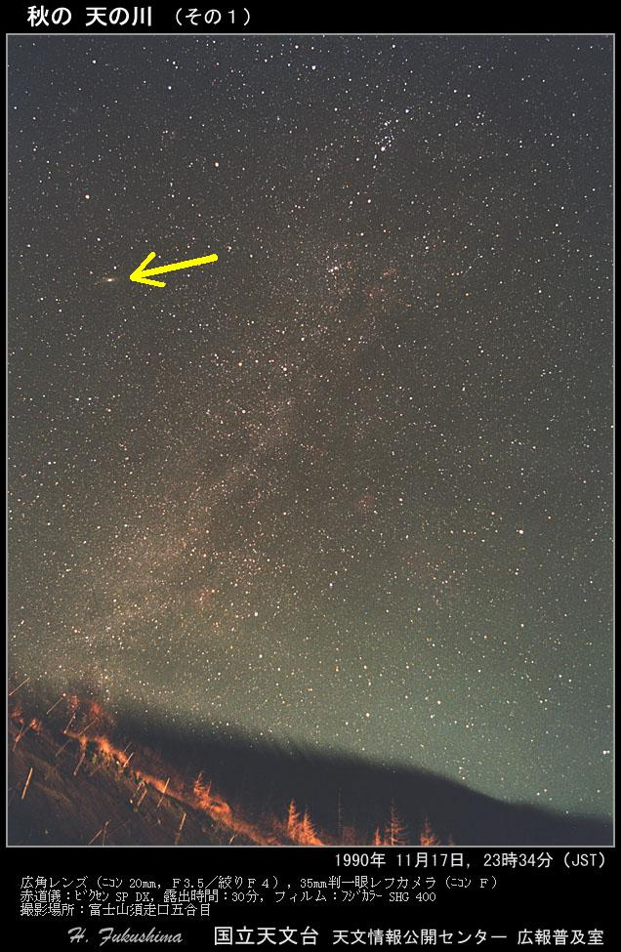

Slide 25
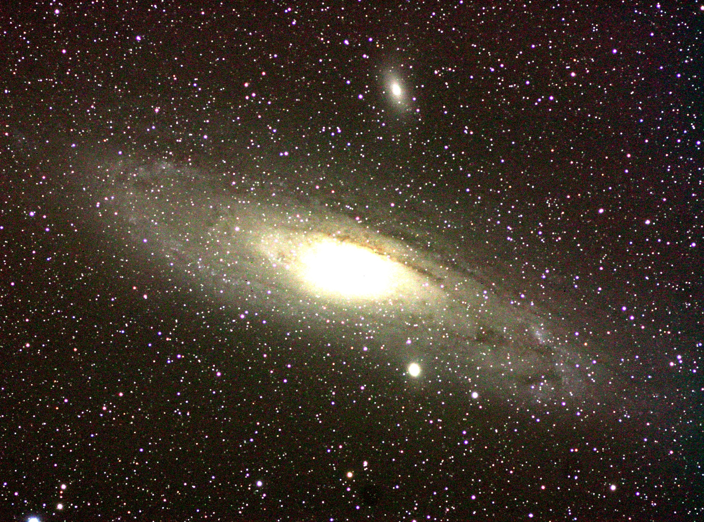
天文学ゼミ学生撮影

Slide 26
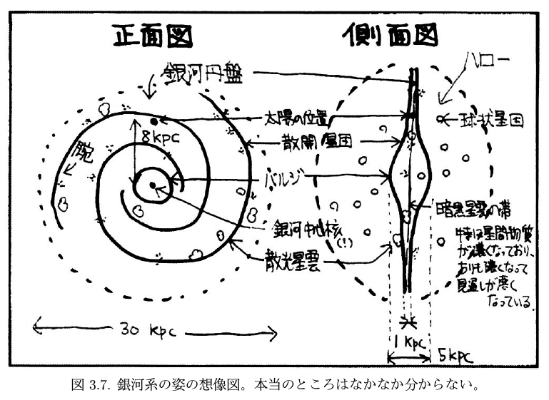
The home of a big family of stars and nebulae where stars are formed.
The Galaxy, the Milky Way
face-on view
edge-on view
galactic disk
Solar system is here
halo
arm
globular cluster
open cluster
bulge
zone of dark nebulae
galactic nucleus
At the equatorial plane of the galactic disk, the interstellar medium settles down and its density is higher. The dust is also concentrated into this zone, thus, preventing the background light of stars from viewing, making the dark patches lanes.
diffuse nebula
銀河系（私たちの住む、天の川として見ている系）の中、太陽系は中心から外れて位置している。
The solar system is off the center of the Galaxy, the Milky Way galaxy, the system we see as the Milky Way from Earth.
Note: Recent studies show that our galaxy is relatively “barred” spiral galaxy which has a bar-like bulge structure rather than a round-shaped one.

Slide 27
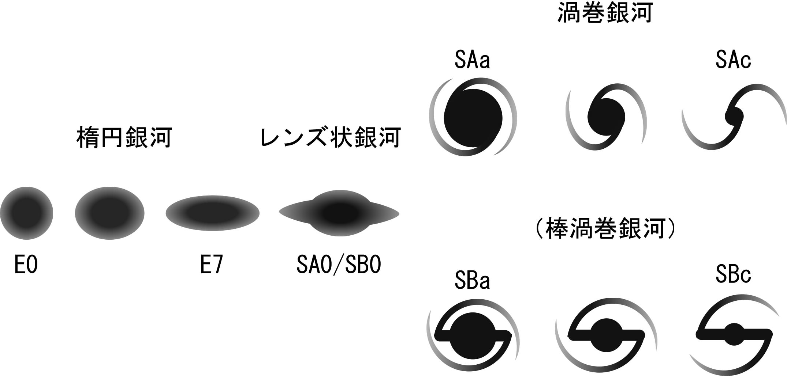
銀河形態の、ハッブルによる「音叉型」分類
Tuning-fork classification of galaxy morphology by Hubble
spiral galaxy
elliptical galaxy
lenticular galaxy
銀河系はこのあたり？
Our Galaxy is around here?
(barred spiral galaxy)
扁平に見える方向からの図
The edge-on view where we can see the flatness of elliptical and lenticular galaxies
円盤部分を正面に見た図
The face-on view of spiral galaxies

Slide 28
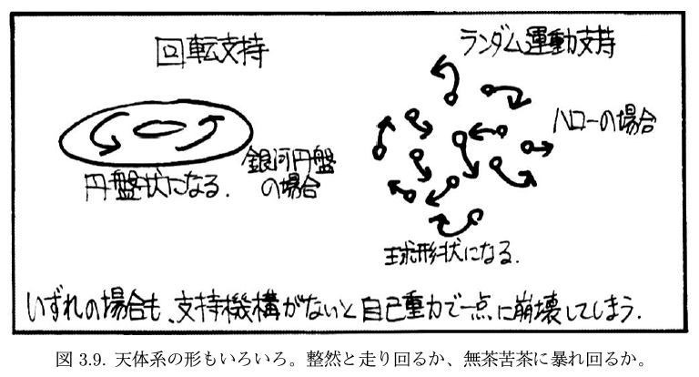
Shape reflects physics.
重力を「圧力」あるいは「ランダム運動」で支えると「球形」、
自転が卓越すると、遠心力がきいて「円盤状」になる。
When gravity counteract with pressure or random motion, the object becomes spherical. When rotation dominates, centrifugal force makes the object “disky.”
rotation-support system
random motion-support system
ex. galactic disk
ex. galactic halo
becomes disky
becomes spherical
In either case, without the supporting system, the object would collapse into a point by the self gravity.
太陽系は、銀河系円盤に乗り、銀河系中心を中心に公転している。その周期は２億年程度。
The solar system orbits around the galactic center, riding on the galactic disk.
The period of the revolution is about 200 million years.

Slide 29
宇宙の階層構造
Hierarchical structure of the universe
clusters of galaxies
galaxy
銀河団
解説
銀河
銀河
galaxy
太陽系 星 | 星団 星雲 | 銀河 | 銀河団 | 宇宙の 地平線
Solar system, star star cluster, nebula galaxy clusters of galaxies horizon of
the universe
世帯 | 市・町・村 | 県 | 国 | 地平線
House City State Country Horizon
○○市
city
○○県
柴田晋平氏の資料より
国
state
country

Slide 30
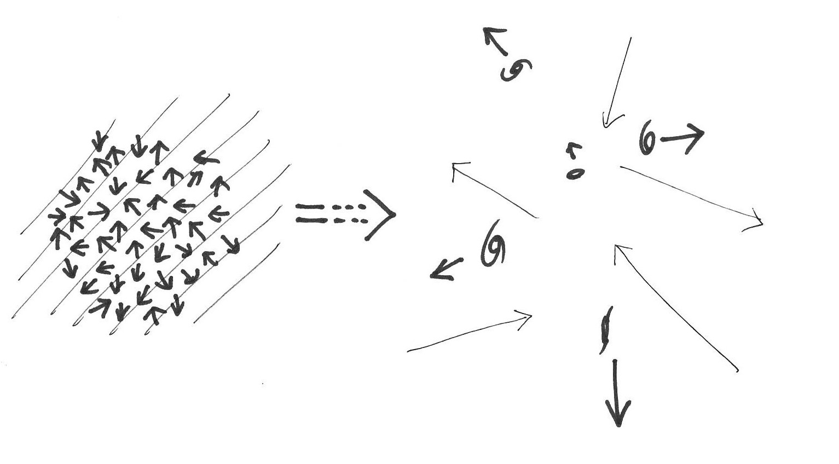
The Big Bang Cosmology
宇宙背景放射 cosmic background radiation
重力による構造形成
Structure formation through gravity
高温・高密度時に飛び回っていた光子が、138億年の時を経て、今も飛び込んでくる。
After 13.8 billion years, the photons which ran around in the high-temperature and high-density space are coming around even now.
ほぼ一様等方な物質分布
Almost completely homogeneous and isotropic distribution of the matter
ムラが大きい
dense / less dense
a large variation
銀河 galaxy
輝く空間内の
光子
Photons
in the shining space
この間、138億年
13.8 billion years
宇宙の膨張 expansion of the universe
ビッグバン直後
Just after the Big Bang
広大な空間 vast space
高温・高密度の密小な空間
High-temperature, high-density compact space
どこから見ても、互いが離れ合うように見える。局所的に静止していても、互いに離れ合うように見える。それぞれの場所の間の空間が膨張している。
From different viewpoints, other galaxies appear to be moving farther from each other. Even though they are still on their local coordinates, they appeared to be separated from each other, due to the expansion of the space between them.
観測事実 1,2 などから、ビックバン宇宙論を組み立てている。
From observational evidences including 1 and 2,
we construct the Big Bang cosmological model.

Slide 31
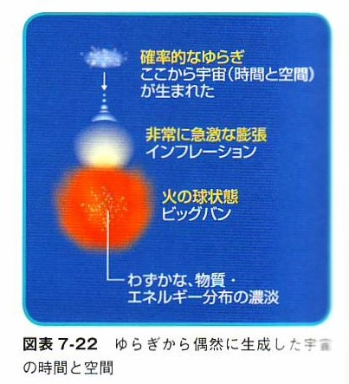
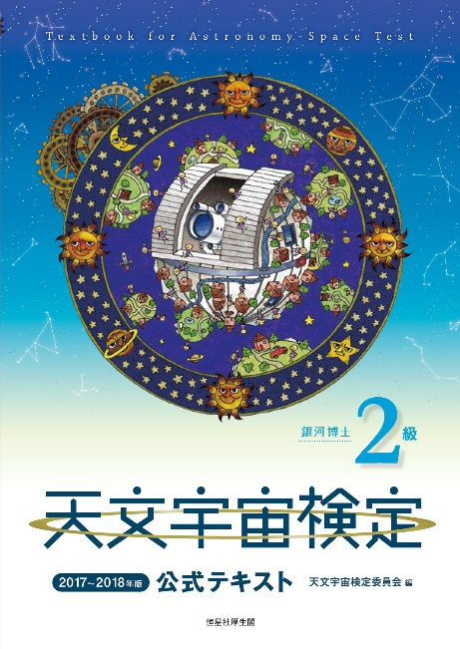
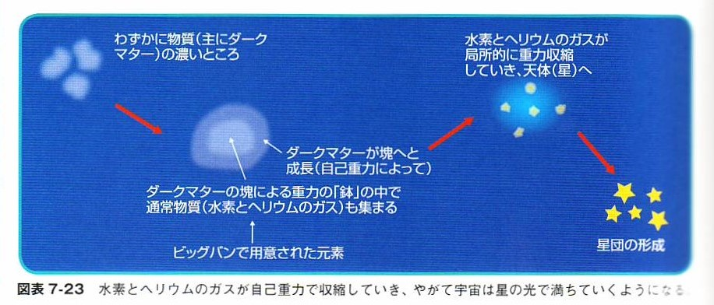
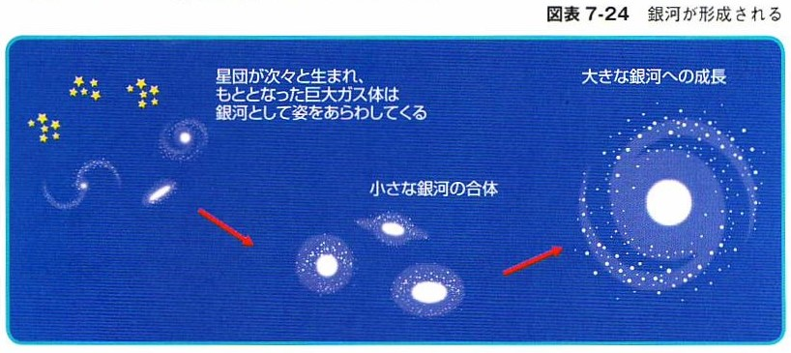
From a certain statistical fluctuation in space and time, the universe happened 13.8 billion years ago.
Very rapid expansion called inflation occurred, though the mechanism is unknown.
The fire-ball state, in a narrow sense, we call it the Big Bang. It contained a slight special fluctuation of matter and energy, which later made the objects by gravitational instability.
The region with slightly higher density of matter, most of them are of dark matter…
By the self gravity, the clumps of the dark matter grew. The distribution of the ordinary “luminous” matter, that is gas of H and He which were forged at the instance of the Big Bang, followed the gravitational “well” made by the dark matter.
The gas of H and He collapsed locally, turning into the objects.
The star cluster formed.
第7章 銀河の世界
（富田晃彦 担当）より
Chapter 7
Realm of galaxies
(Tomita, A.)
In the beginning, no one knows, but physics researchers say that…
The star clusters formed one after another. The huge clouds of gas turned into galaxies.
Smaller galaxies collided with each other…
…have grown into a giant galaxy.

Slide 32
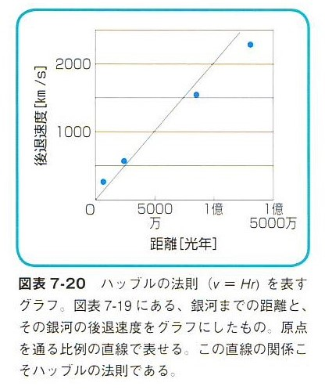
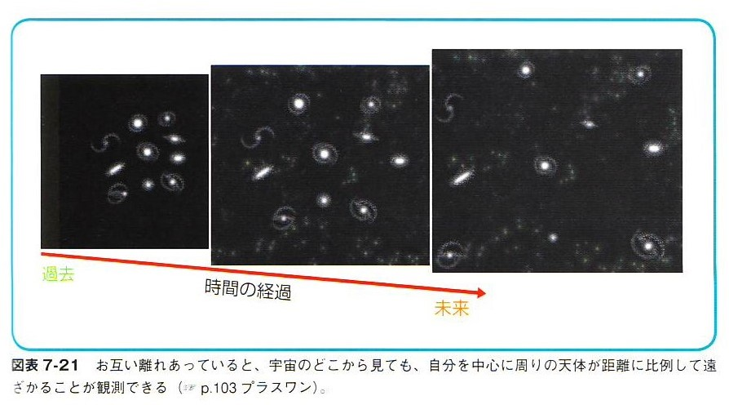
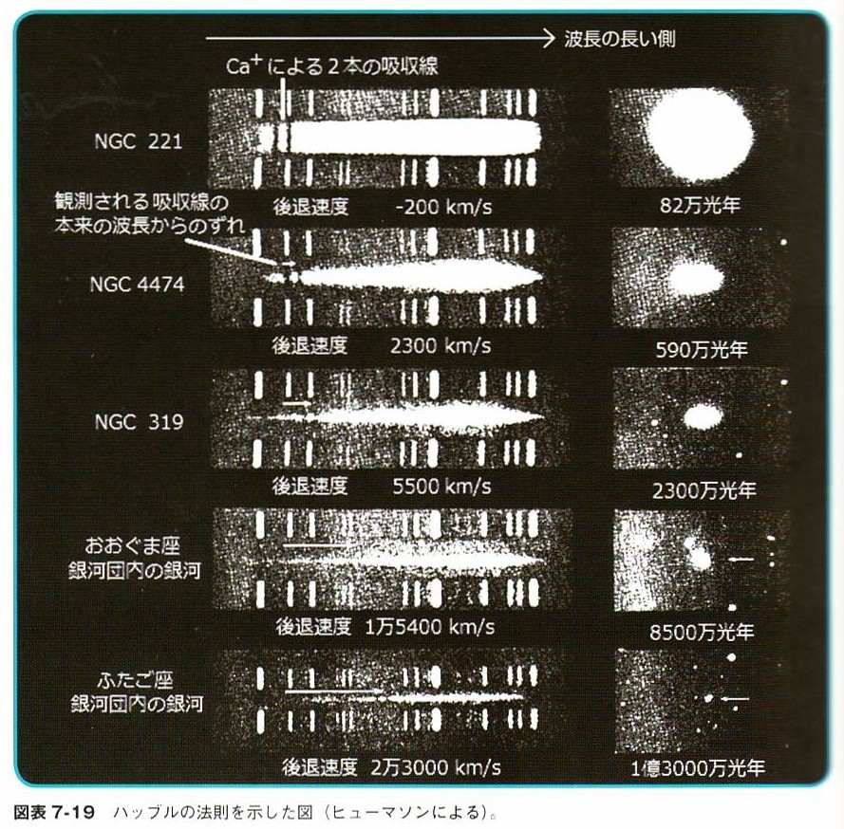
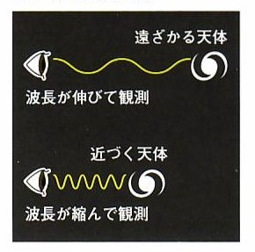
How do we learn the expansion of the universe?
recession radial velocity
The diagram of the Hubble’s law is interpreted to be the expansion of the universe.
The expansion of the universe makes the diagram of the Hubble’s law, or Hubble–Lemaître law.
The expansion of the universe is explained that as time passes, galaxies appear to moving farther away like schematic figure below.
distance
The picture on the right shows an example of real data of
Hubble’s law. Note the absorption lines by ionized calcium, the Fraunhofer H and K lines (not hydrogen and potassium)
Some background for understanding the figure
The galaxy’s light is the integration of lights of many stars.
The star’s spectrum is basically the continuum + some absorption lines.
The shift in wavelength is easily recognized by the positions of the absorption lines.
The gas emission is seen as the emission lines, which is much easier to identify.
In Physics, the shift of wavelength in the line spectrum is interpreted as the motion of the light source known as Doppler shift of light.

